Slide 1

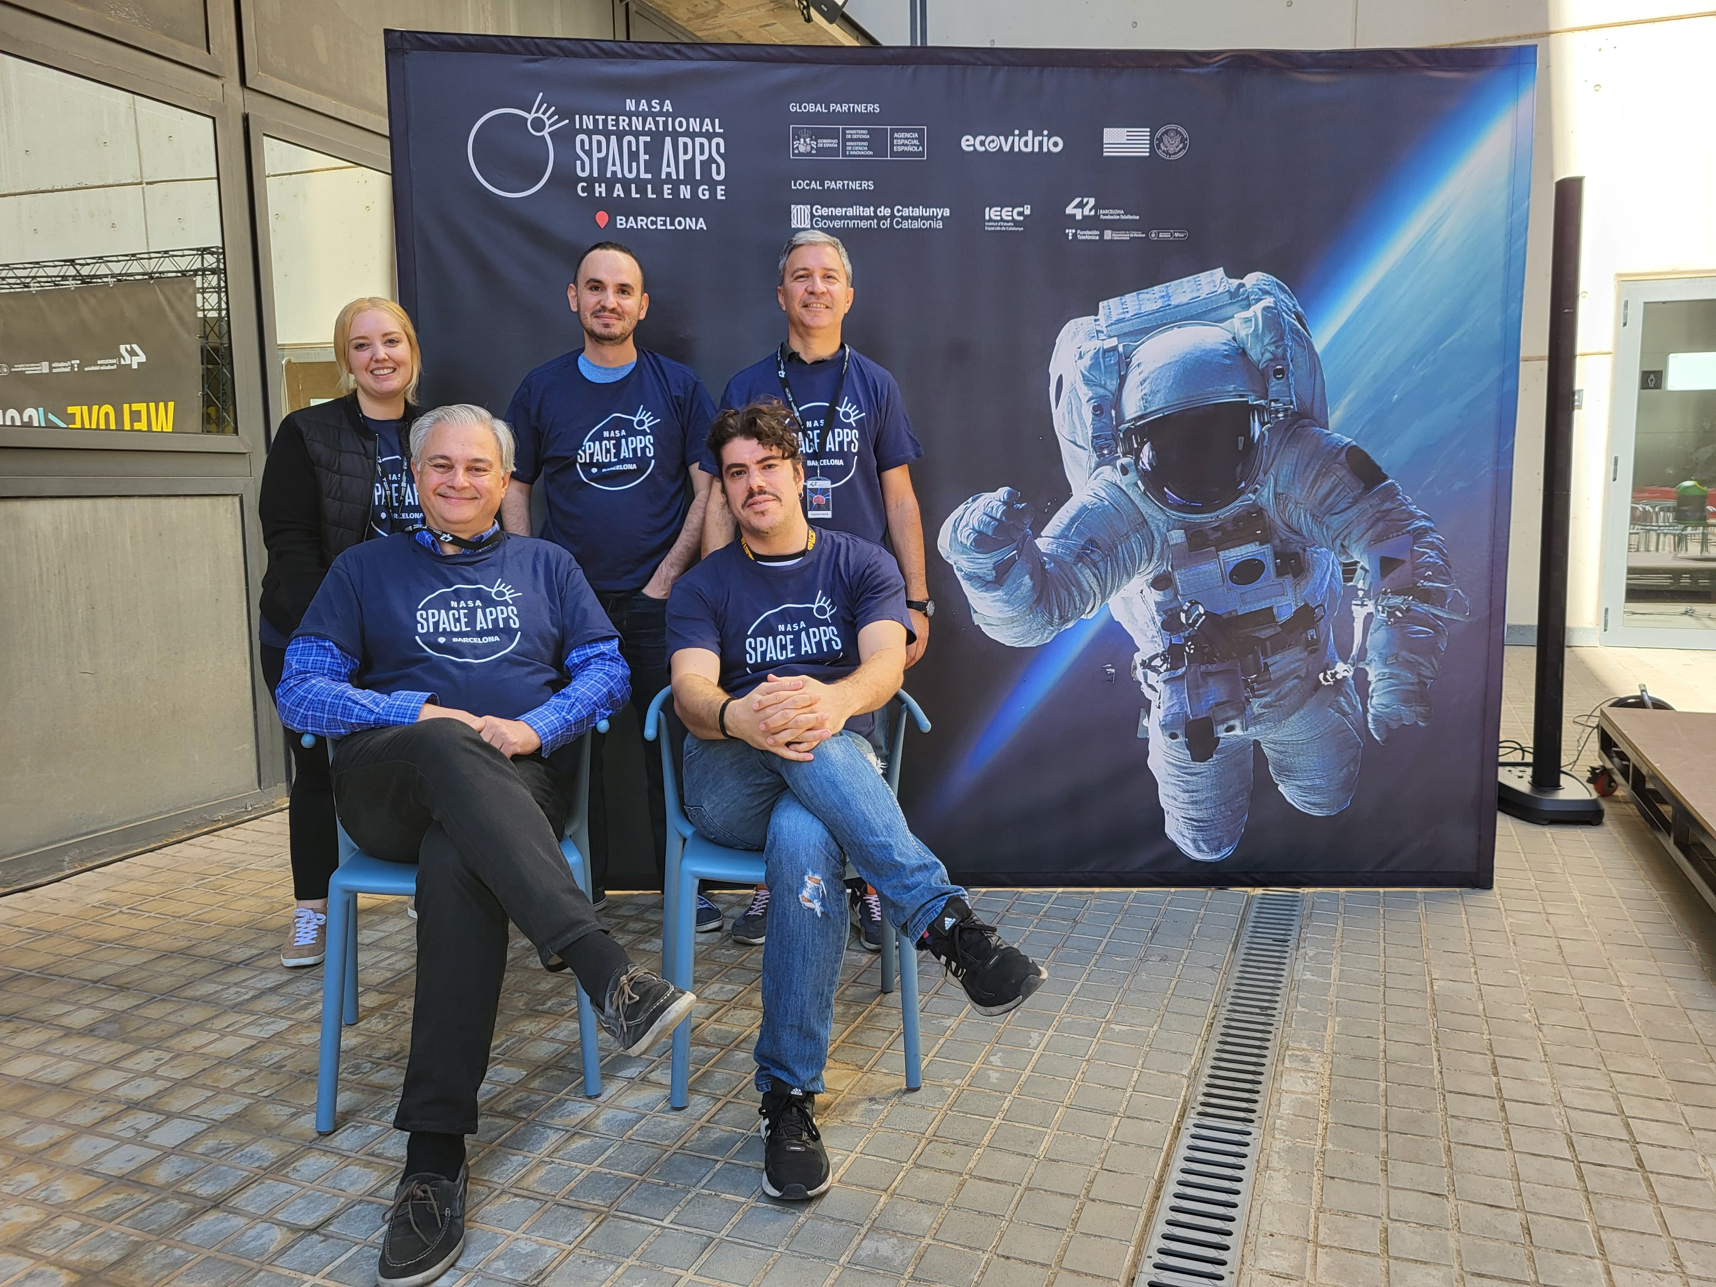

Slide 2
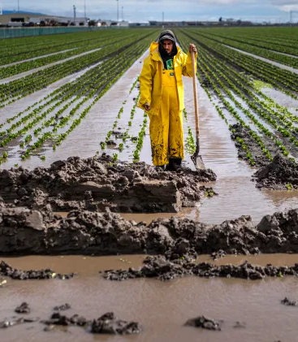
Why?
In today’s world, we suffer:
Unpredictable weather
Pests
Deseases
These affect farmers:
Planting and harvesting schedules are disrupted
Crops are damaged
Livestock is affected
All of us are affected, because crops and livestock are a critical source of food.
Credit: Getty Images

Slide 3
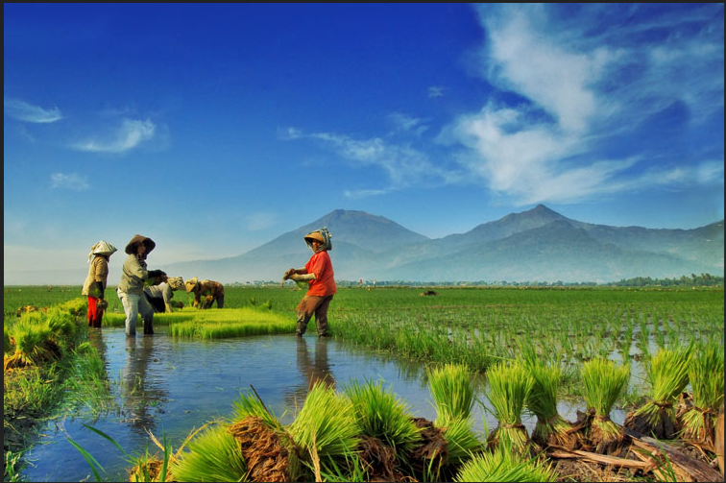
Why?
Farmers need support against these issues, by means of improved weather data and predictions (more precise, timely, adapted to their specific crops / livestock)
This will enable farmers to:
Make informed decisions based on relevant, useful, actual data
Manage the risks of drought and floodings and use water efficiently
Improve their farming practices
Optimize production
In turn, this contributes to a steady supply of food, which benefits farmers and consumers (predictable deliveries, stable prices).
Credit: nooreva

Slide 4
How?
NASA and other Space Agencies have a wealth of information.
We will publish that information in a way which is accessible and understandable to farmers, by means of an app.

Slide 5
What?
We designed a multiplatform app to run on:
Smartphone
Tablet
Web browser
With:
User-friendly interface
Dashboard
Sourcing data not only from the Space Agencies, but from the farmers themselves as well

Slide 6
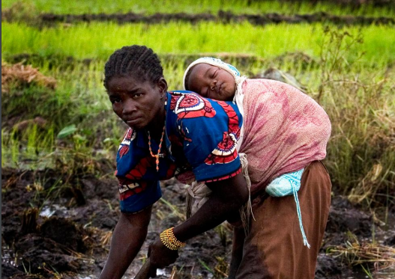
Who?
The app will be available to different people with different perspectives:
Farmers (520 million people, around 50% women, 90% less than 10 hectares)
Agronomists
Soil scientists
Laborers
Agricultural communities
The app will also support exchanging messages among them and the use of discussion forums.
Credit: FAO

Slide 7

Critical Success Factors
We consider the following points as most relevant:
Farmer centric design, i.e. base the app on the users and their specific needs
Translate complex data into clear and understandable information
Timely updates and offline availability for away locations with no connectivity or low speed connectivity

Slide 8

Q&A?

